Slide 1
Rotorcraft Engineering: Preliminary Design
“We’re living in a changing world.... We need to change how we work as an industry. We can’t get comfortable with our [high] barriers to entry, that we can move slowly, that we can create at a slower pace than other industries. We’ve not yet had a Tesla come and rev our engines and show us who we need to be. I’d rather out-innovate myself than wait for someone to show me that.”
- MD Helicopters CEO Lynn Tilto, March 2016

Slide 2
Purpose of the course
Introduce basic physics of rotors
‘Stories’ concerning design and development
Rotorcraft community uses a LOT of jargon!
get a quantitative ‘feel’ of the (non-dimensionalised) parameters
(very important for the exams!!)

Slide 3
Exams and Grading
Reading assignments
Project
Final Exam

Slide 4
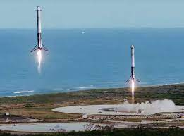
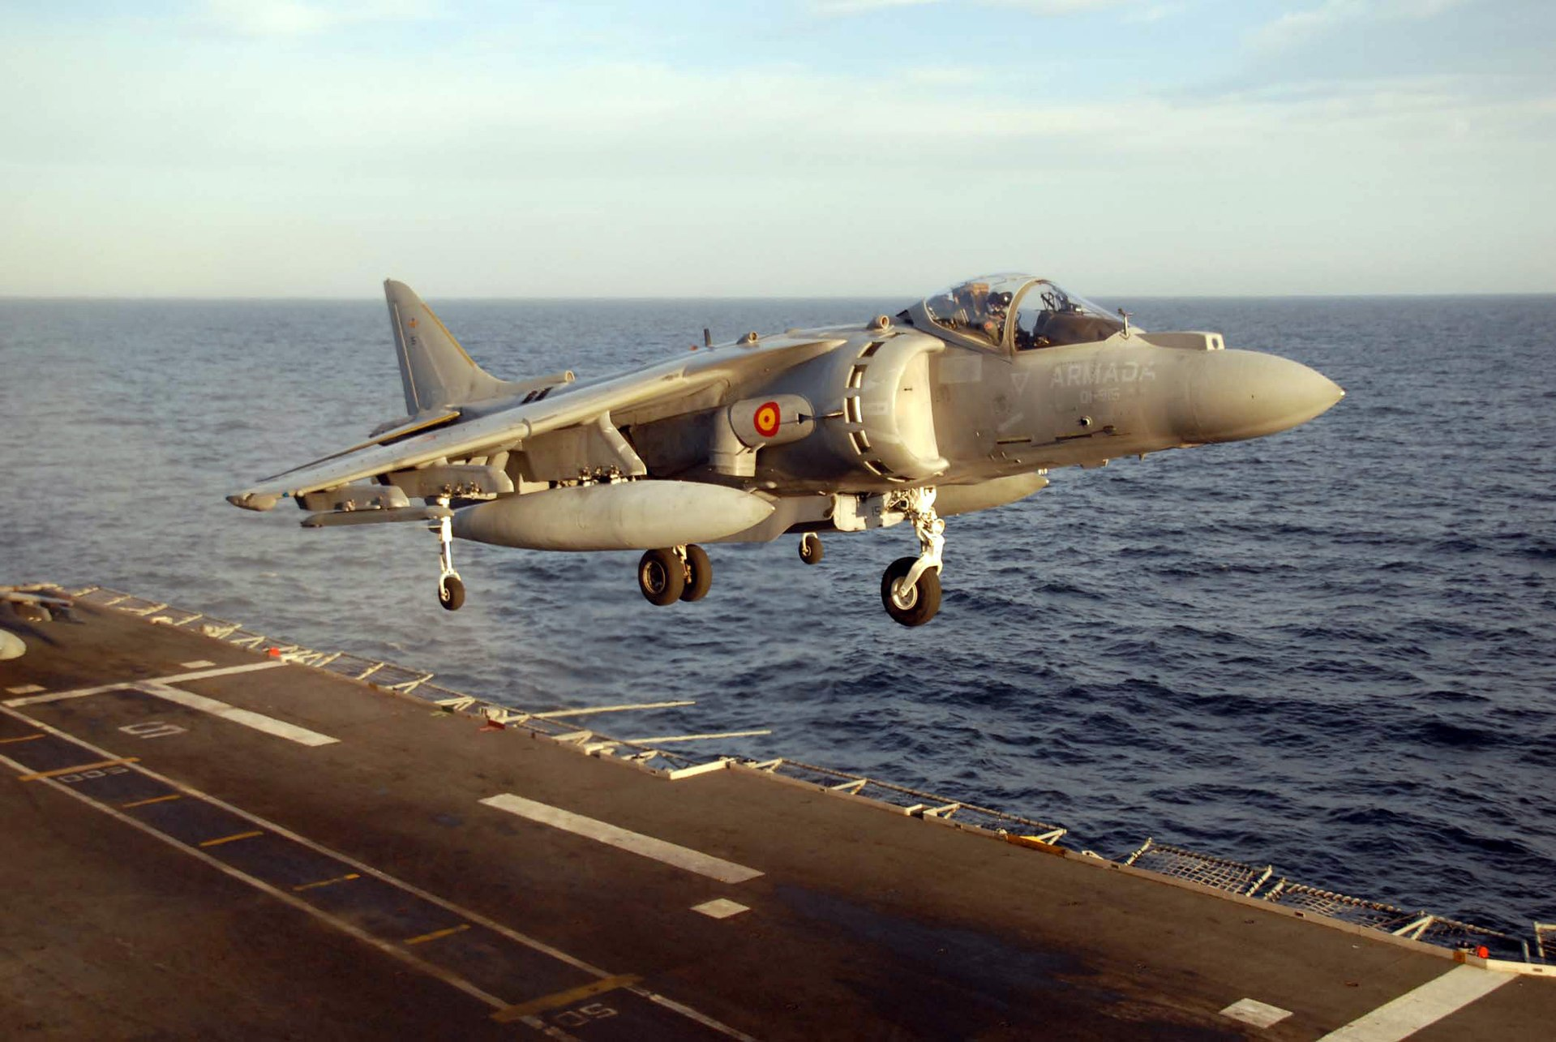
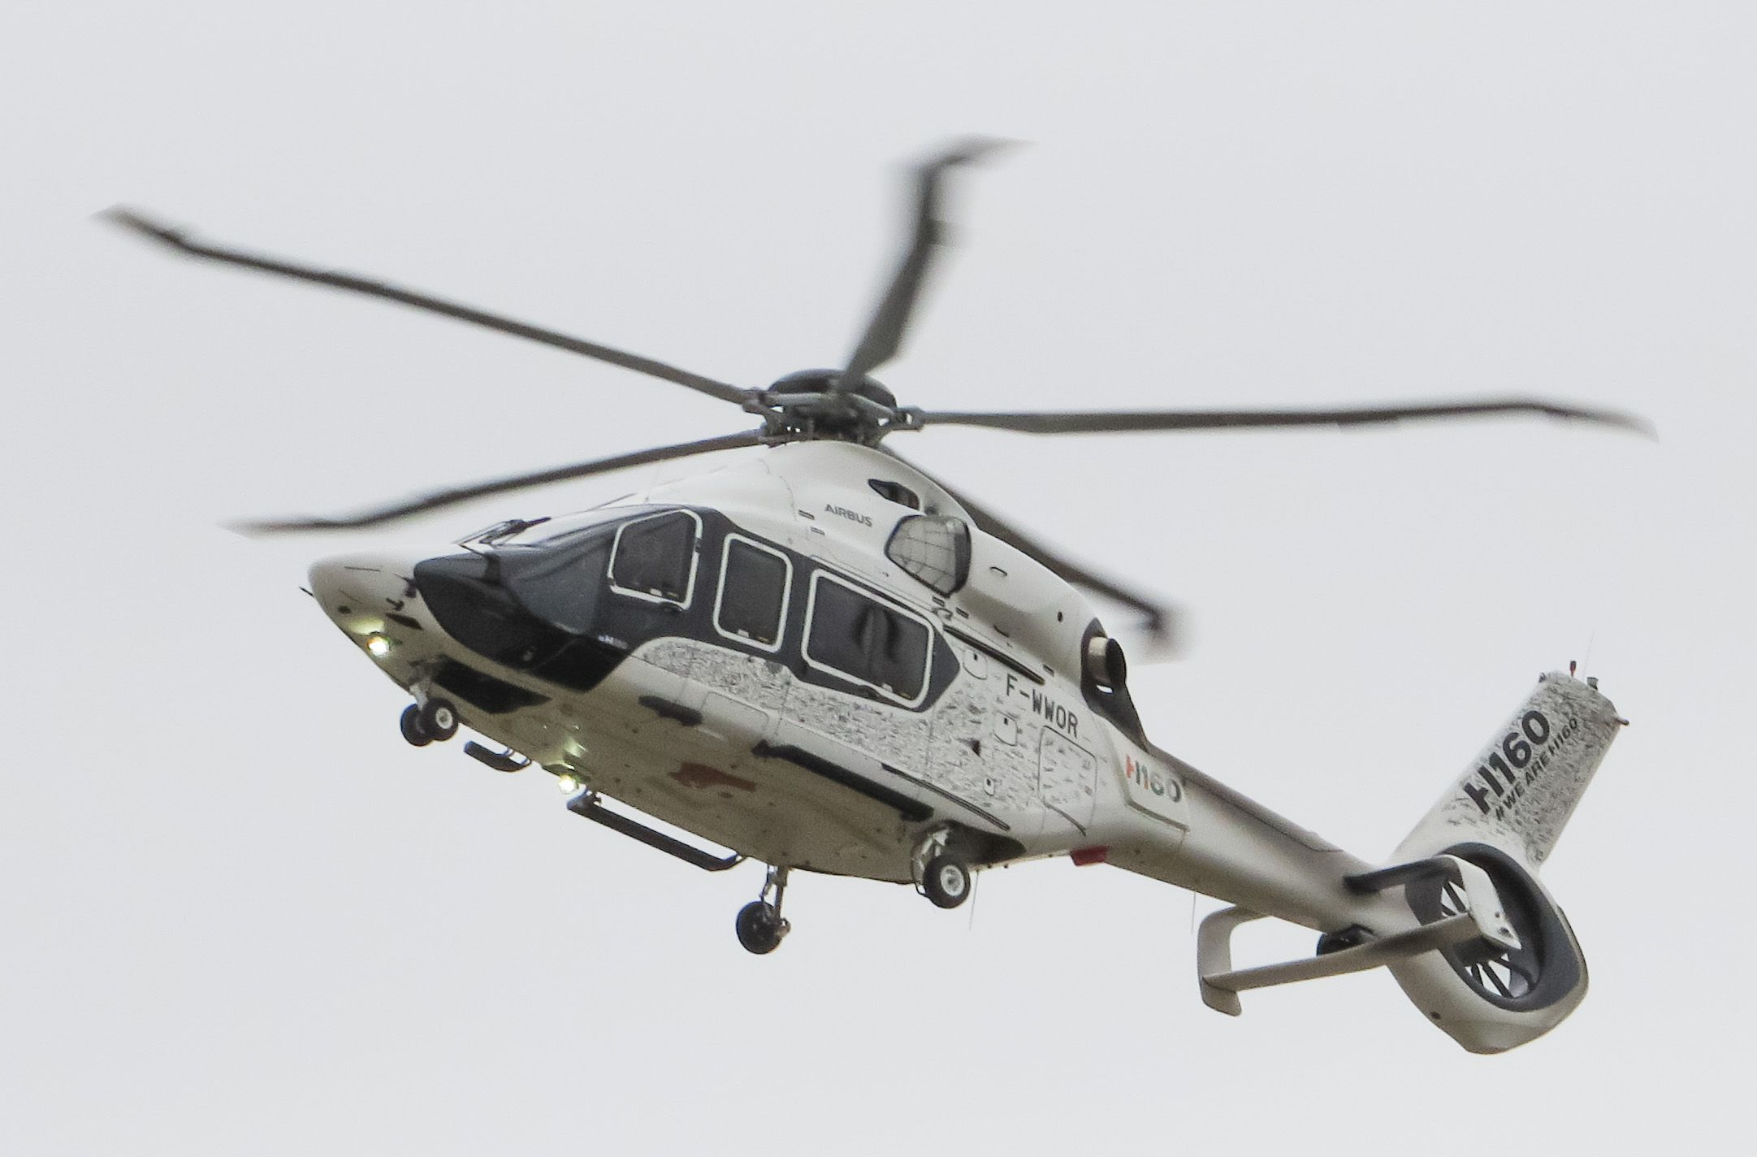
Helicopters or VTOL (STOVL)
The central idea is to take-off and land vertically at BEST EFFICIENCY
Which of the below adhere to this principle best?
why? (hint: large rotor)
A century of research has established the conventional design to be the most efficient (for now!) – caveats (weight class, tandem rotors)
What about the performance outside this manuever?

Slide 5
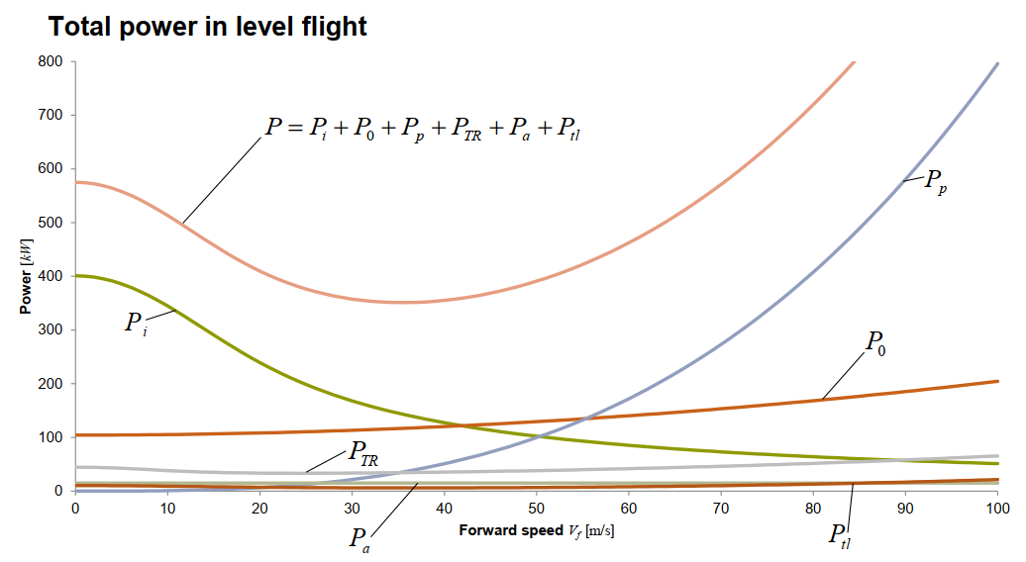
Required power (Bucket) curve

Slide 6
V/STOL aircraft issues^{[1]}
Large thrust mismatch between vertical flight and cruise
either engines must be far more oversized for cruise, or that separate thrust devices are needed purely for the vertical flight
Distribution of the thrust around the center of gravity for hover
Mechanical complexity to facilitate the above
Fuel efficiency
powered lift is inherently less efficient form than aerodynamic lift
using more engines and shafts to drive more propulsors decreases efficiencies further

Slide 7
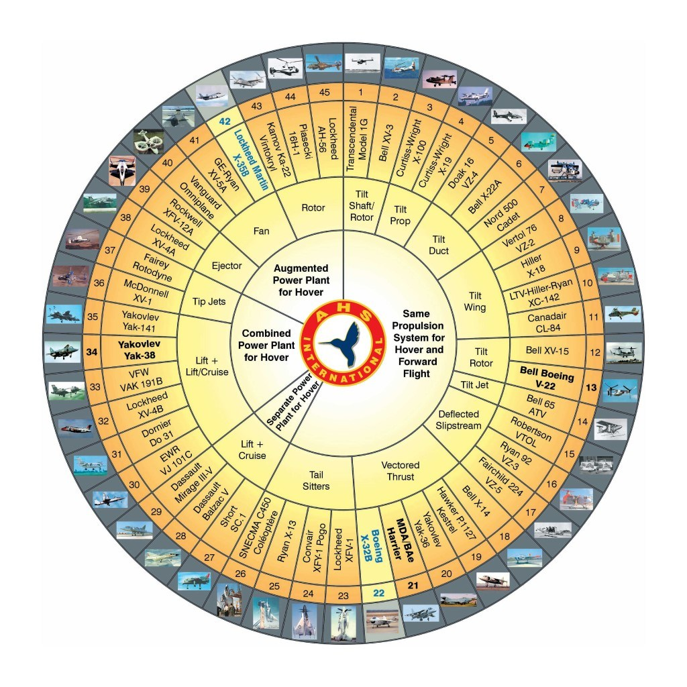
Wheel of (Mis)fortune
Most V/STOVL aircraft never entered production stage
MANY engineering strategies tried out to make helicopters go fast. Almost all failed.
Some strategies making a comeback
piston/turboshaft power different from electric!
advances in structures (this also makes the conventional design more lucrative)

Slide 8
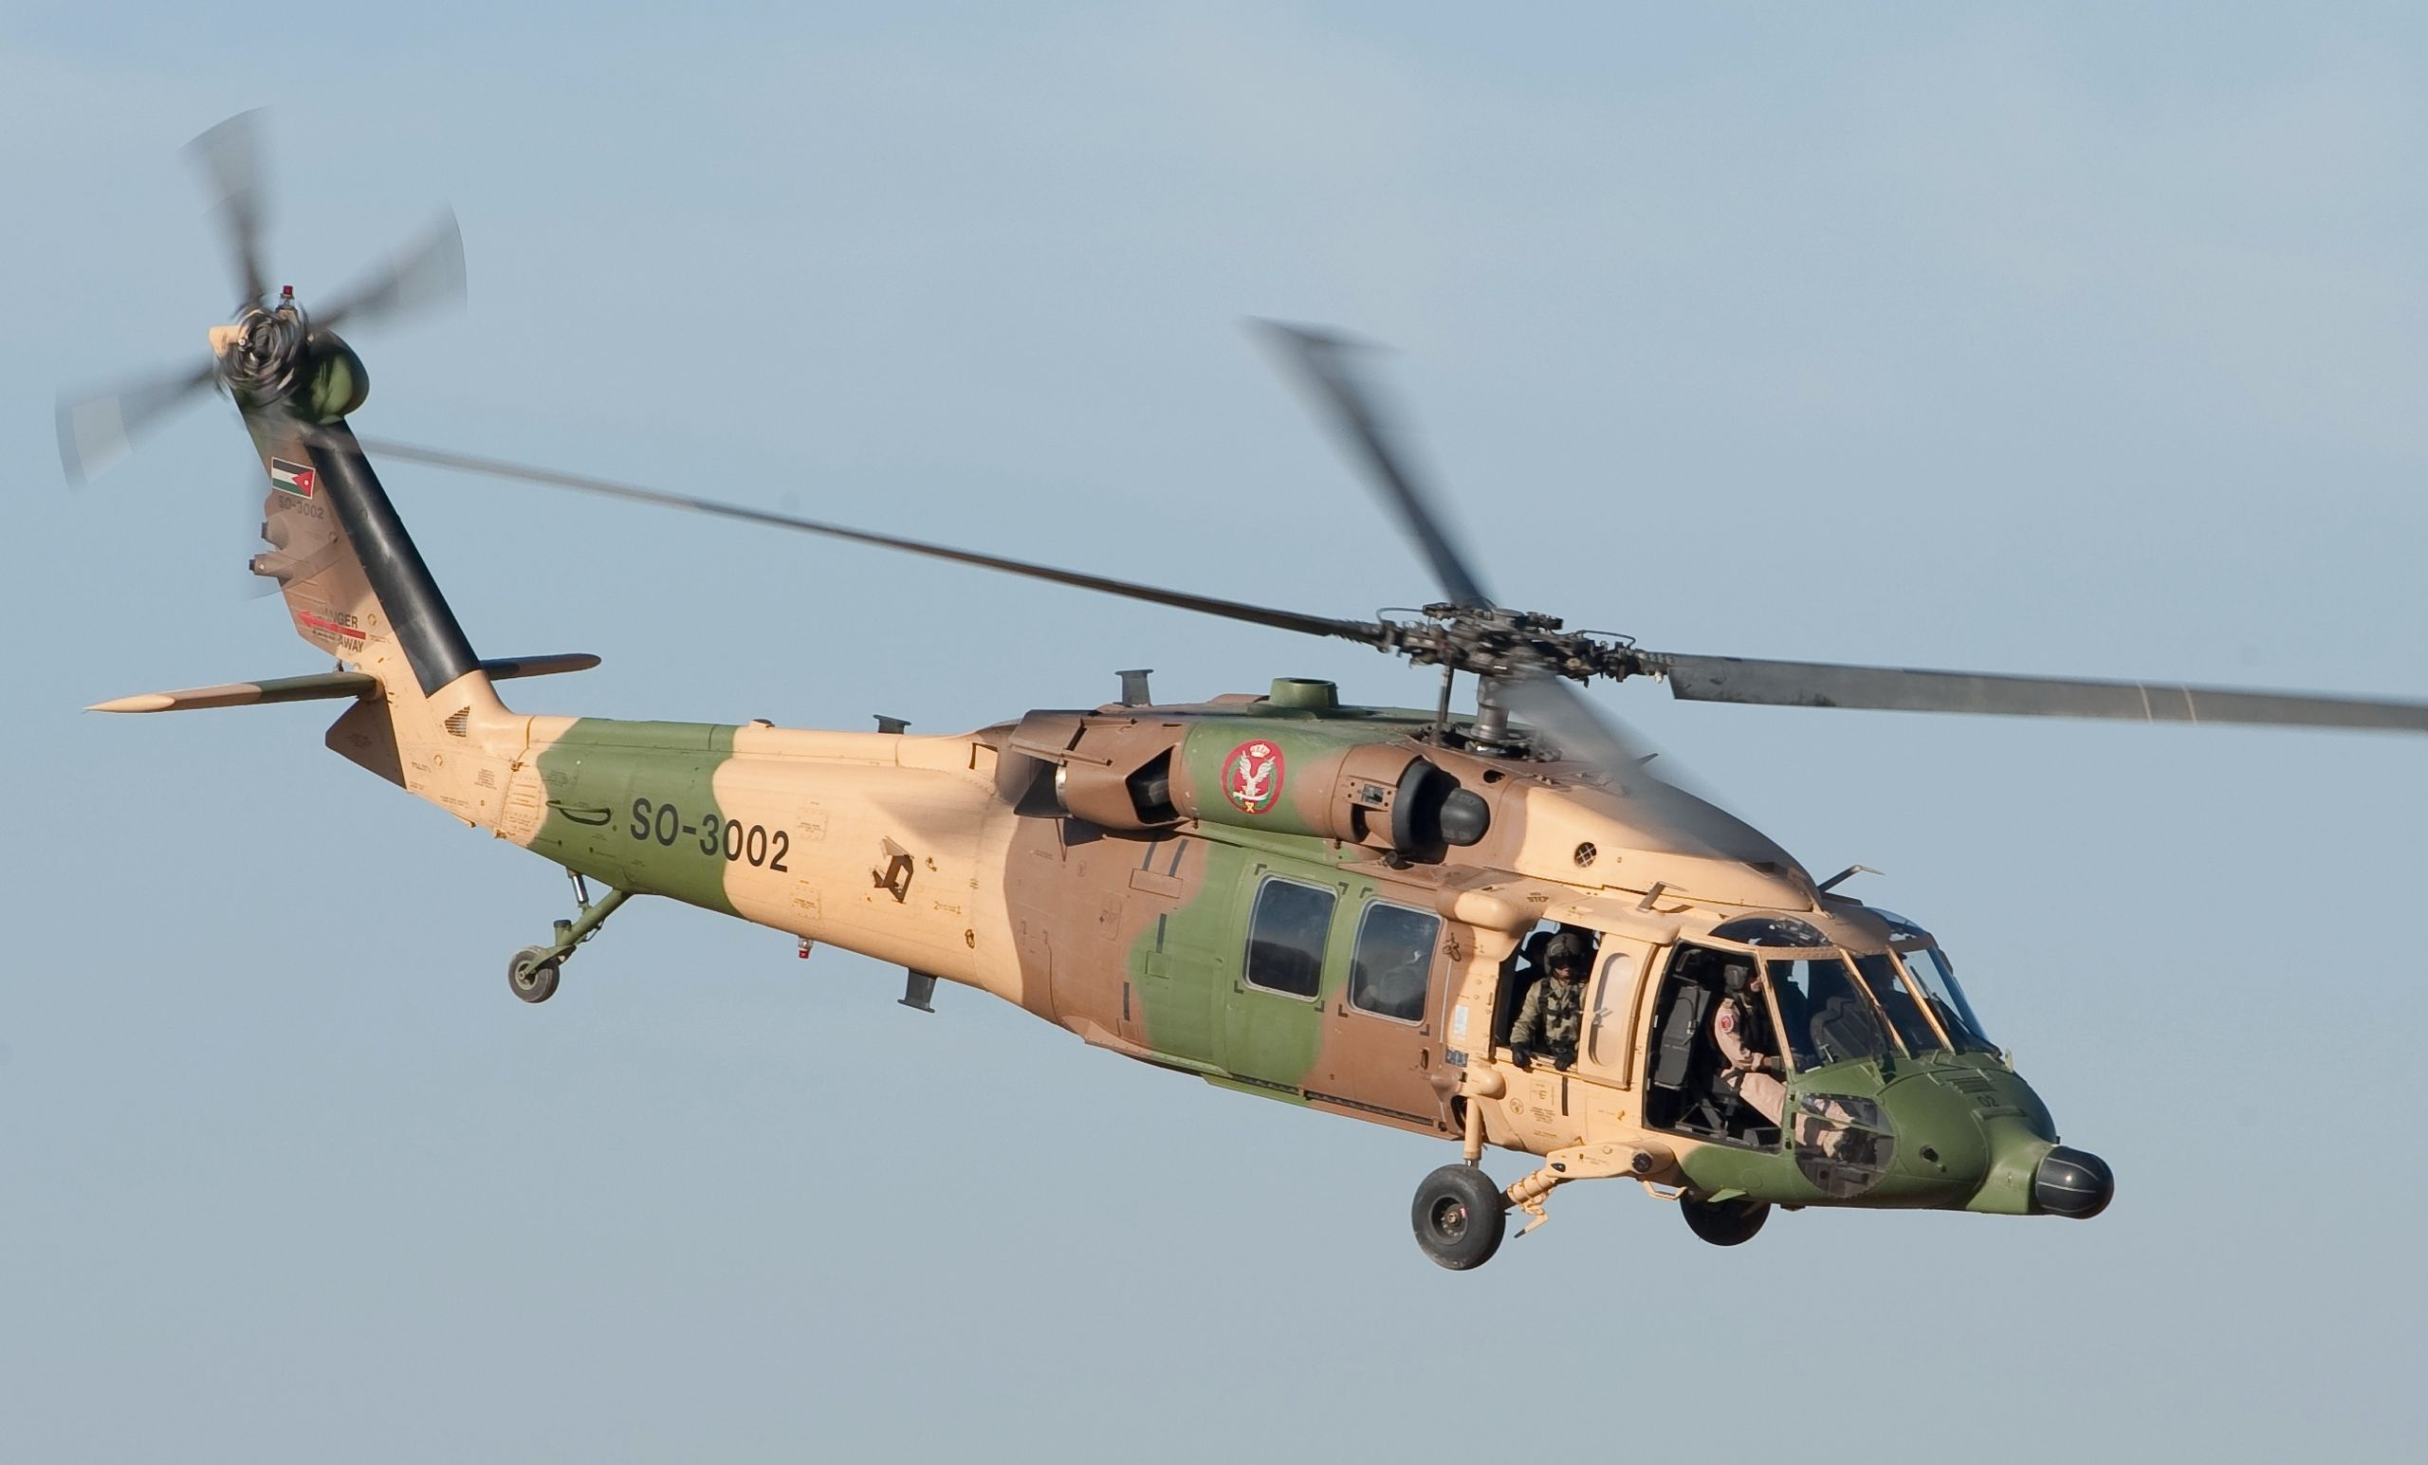
Things to note (no matter the configuration!!)
Net force and angular momentum of the aircraft should equal zero
Vertical component of thrust = aircraft weight
Horizontal component of thrust = aircraft drag

Slide 9
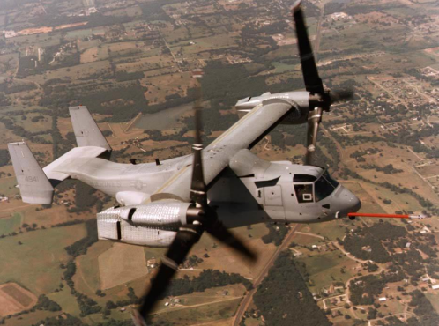
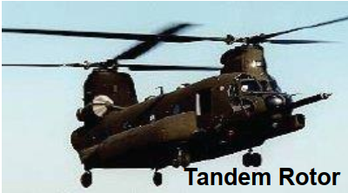
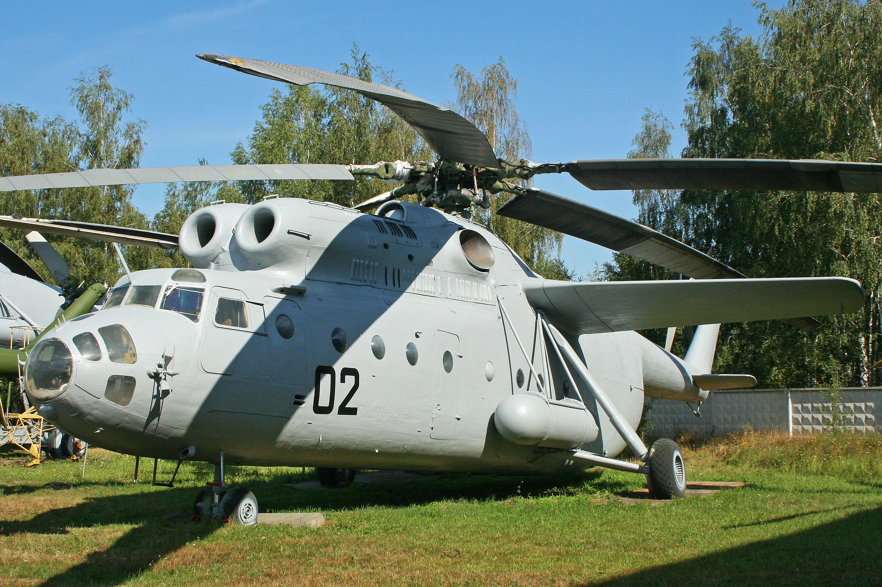
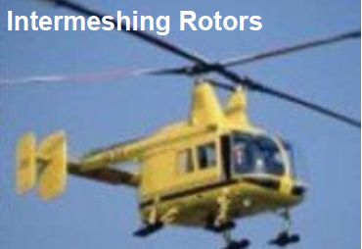
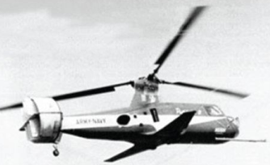
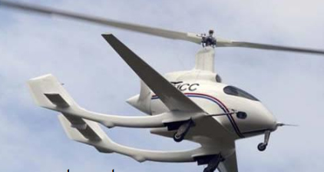
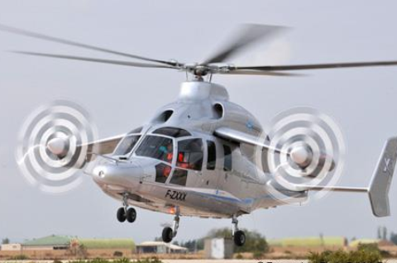
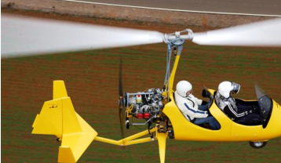
Designs Galore!
Notes:
Rotorcraft design is guided by design philosophies and in-house understanding based on decades of experience within a particular firm from building these machines.
For e.g. not every company is manufacturing tilt rotors. Why?
Basic principles that you learn in the context of conventional design helicopters, or single main rotor designs as they are often called, will be enough to understand how each of these designs work.

Slide 10
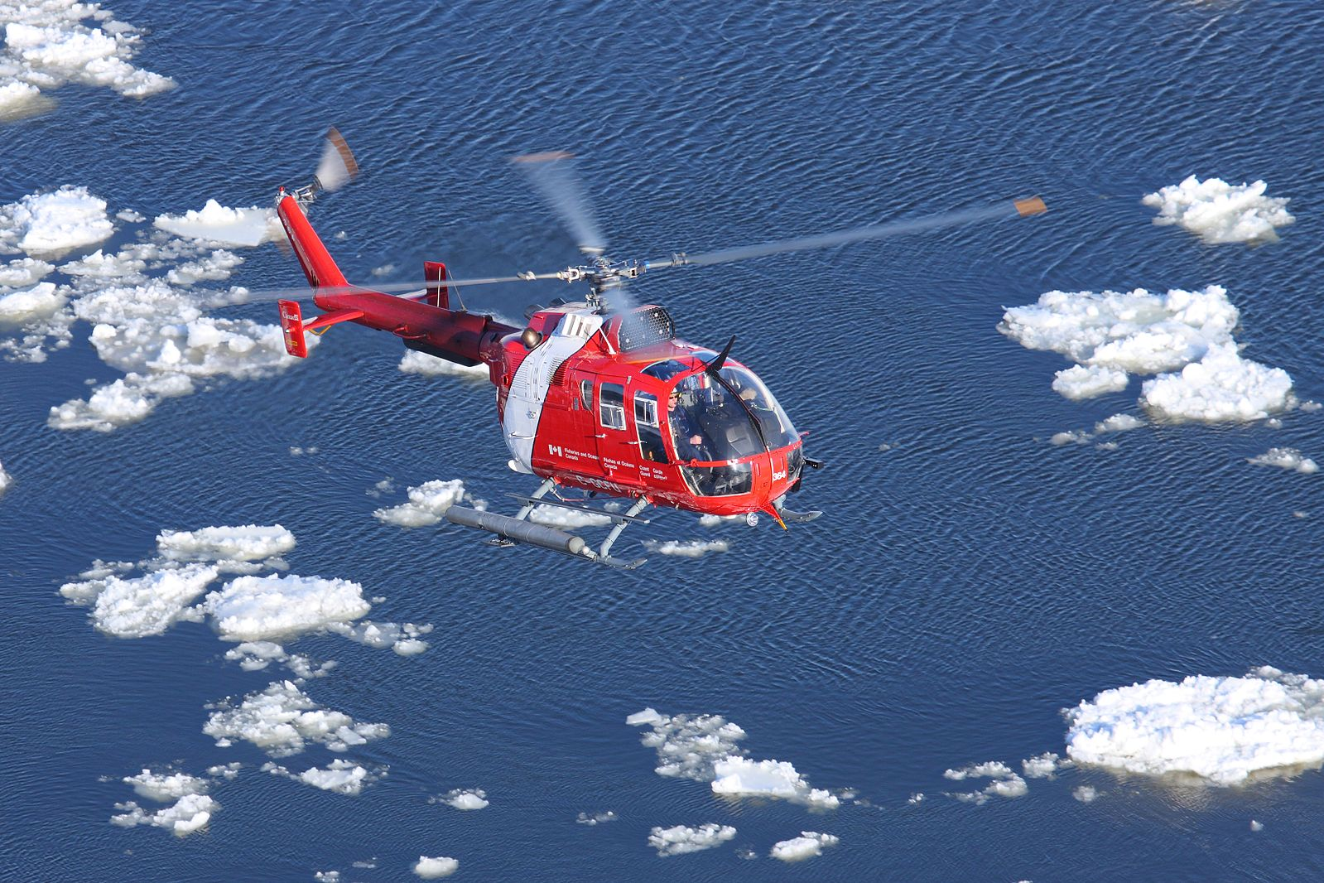
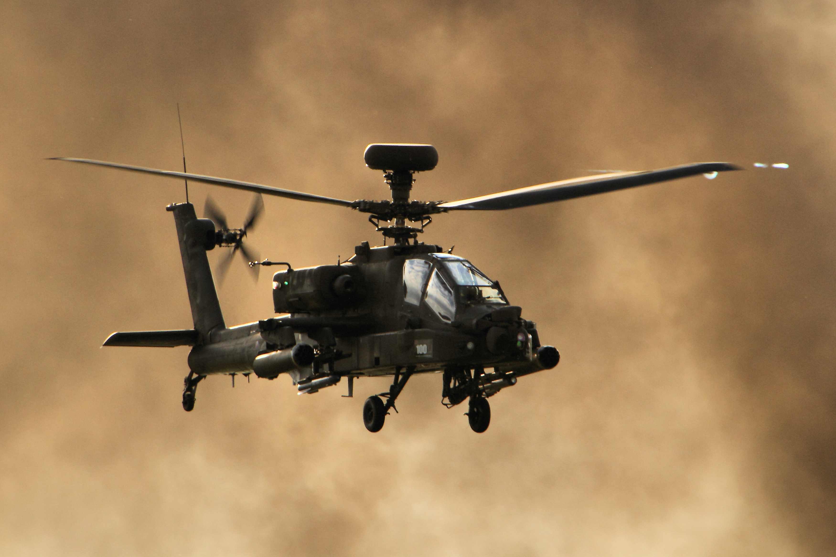
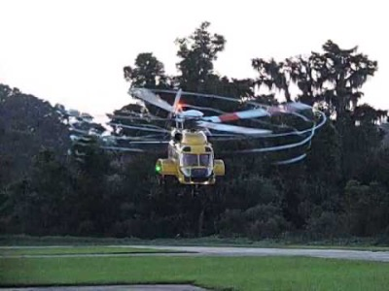
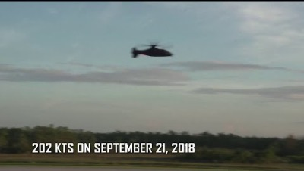
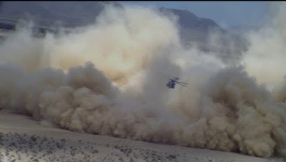
Conventional
The most hover efficient machines.
Tail-rotor consumes about 10% power but generates (almost)no vertical or horizontal thrust
It helps make this design very responsive directionally (unlike coax, syncropter, tandem designs)

Slide 11
The tail-rotor conundrum
Getting rid of the tail-rotor (somehow) seems the most obvious solution
so no wastage engine power (or is there?)
Whenever more than one rotor is involved, the configuration needs to be evaluated VERY CAREFULLY with regard to interactions between the rotors (throughout the flight regime of the rotorcraft!!)
Single rotor design is (almost) IMPOSSIBLE!!!
Ingenious ways of placing the second rotor give rise to different configurations
Loss in directional control

Slide 12
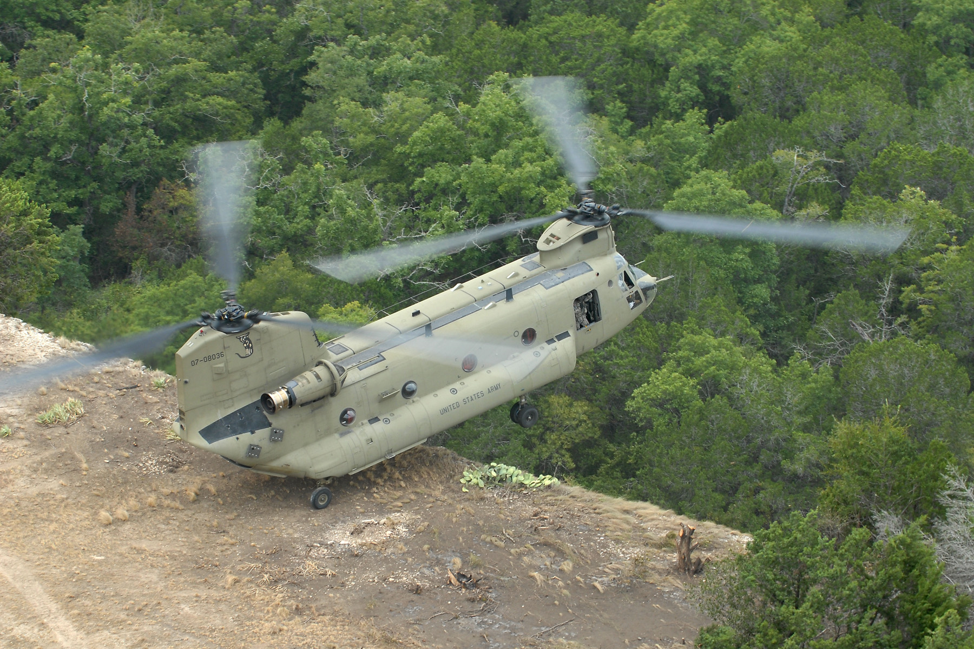
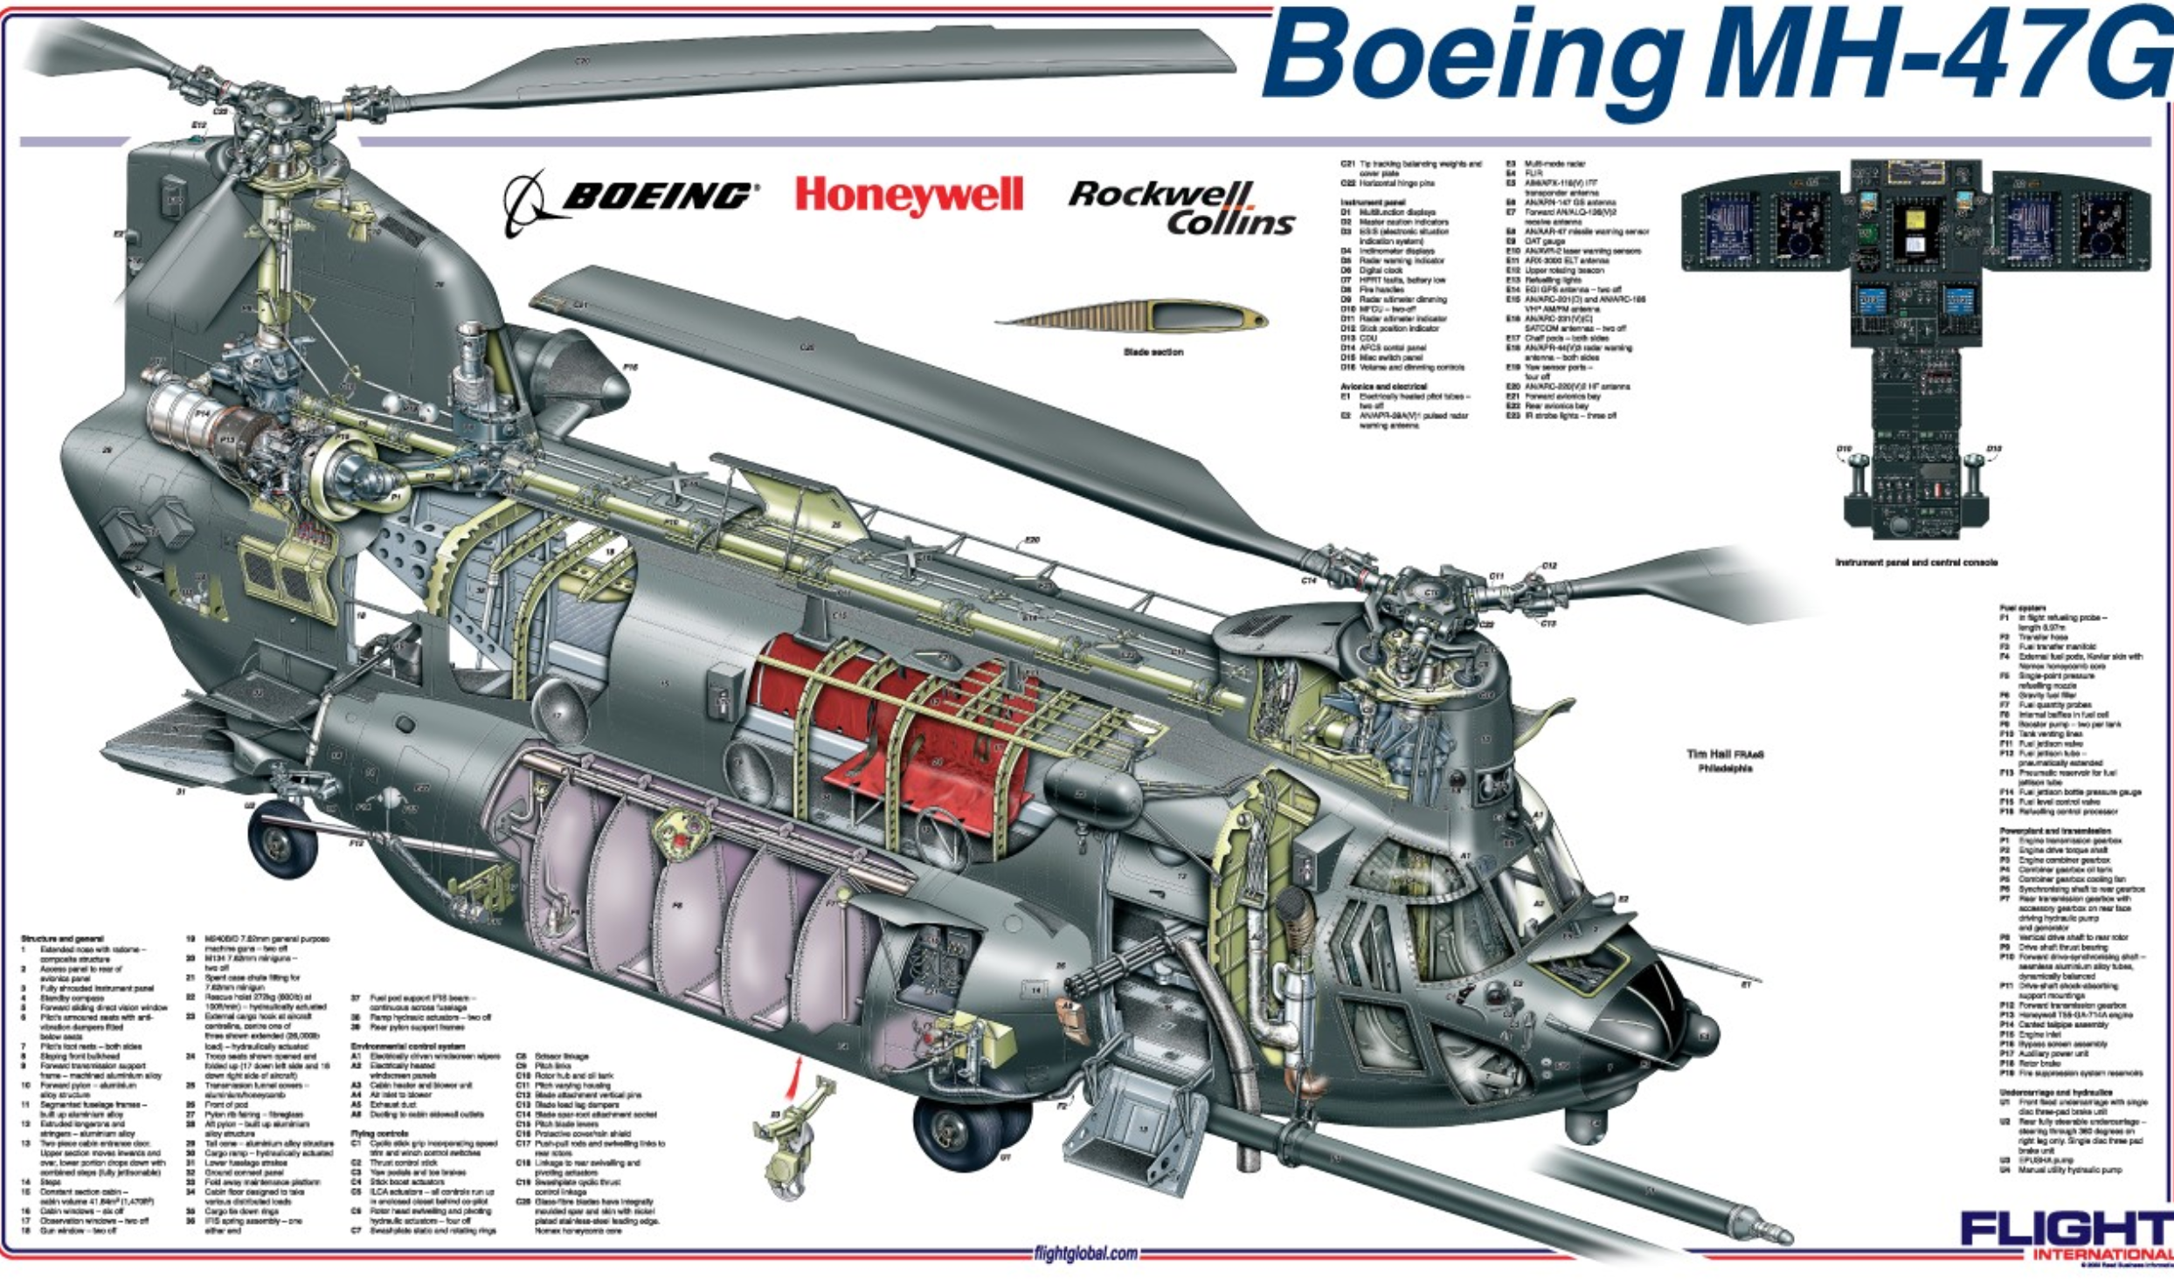
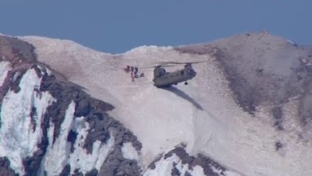
Tandem
Lack of a strong directional stability makes this design
relatively insensitive to wind direction landing on a ship
(or maneuvering in gusty environment)

Slide 13
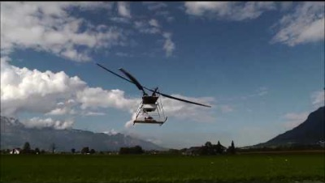
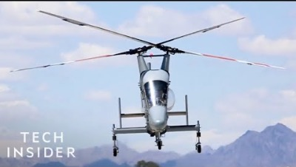
Syncropter
Compact design but larger ground clearance needed (cannot approach from the side)
No tail rotor but neither rotor generates lift entirely vertically
Compensation of yaw directional control using large stabilizers

Slide 14
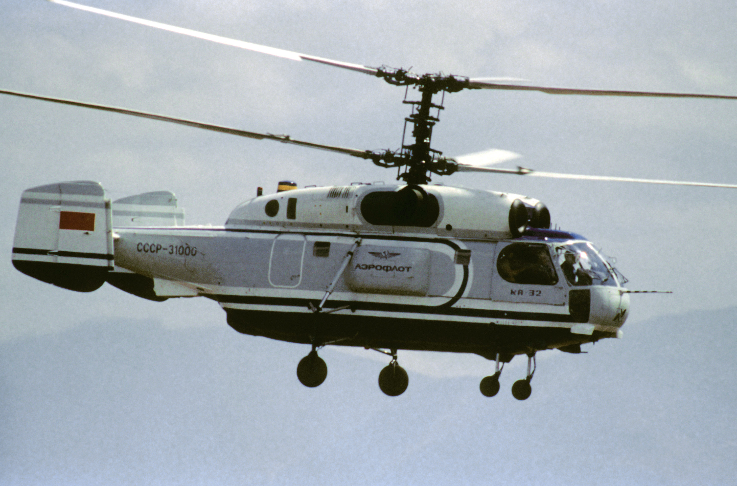
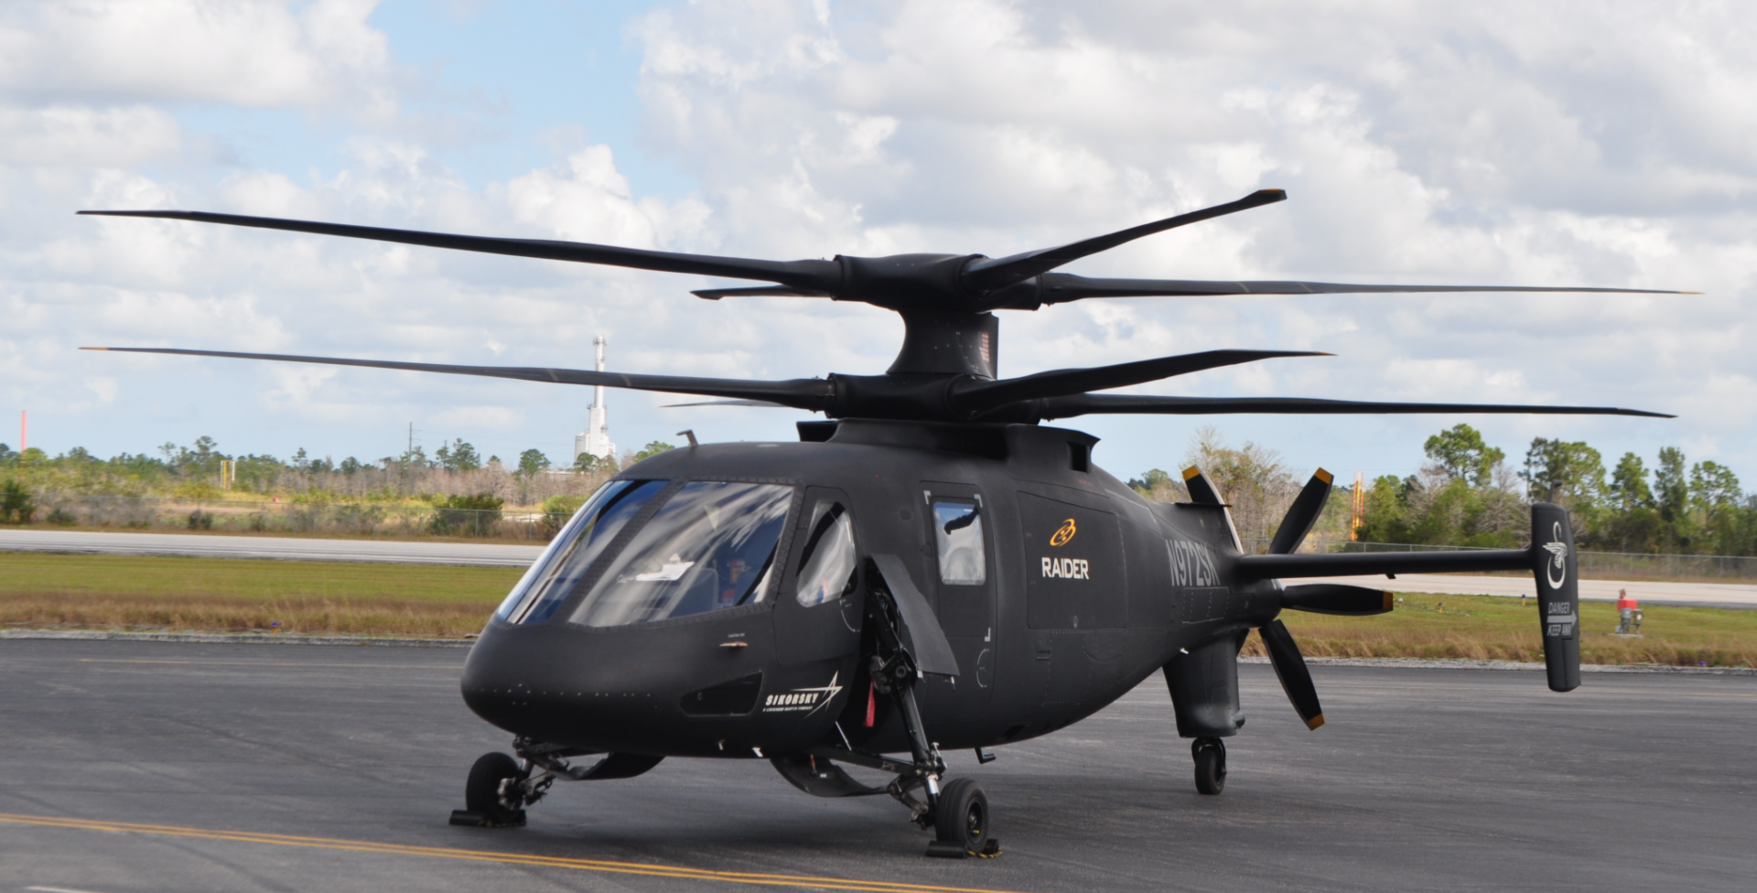
Coaxial (contra-rotating)
Save on swirl losses (but this is low for pretty low for low disk loading rotors anyways)
Rotor separation must be low (otherwise lower rotor in climb)
Compensation of yaw directional control using large stabilizers

Slide 15
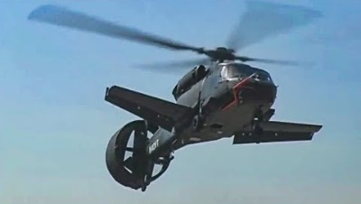
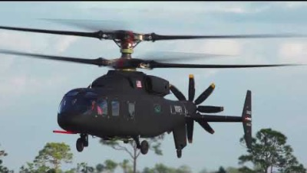
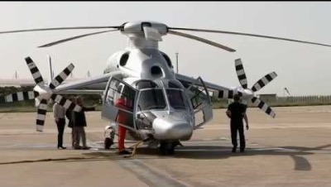
Compound
Rotor in edge-wise flight is not as efficient as a wing (powered vs aerodynamic lift)
X-49-like single rotor design with swivelling wings is (THE ONLY?) one possibility of having a single rotor design
if that is indeed practical is a different question

Slide 16
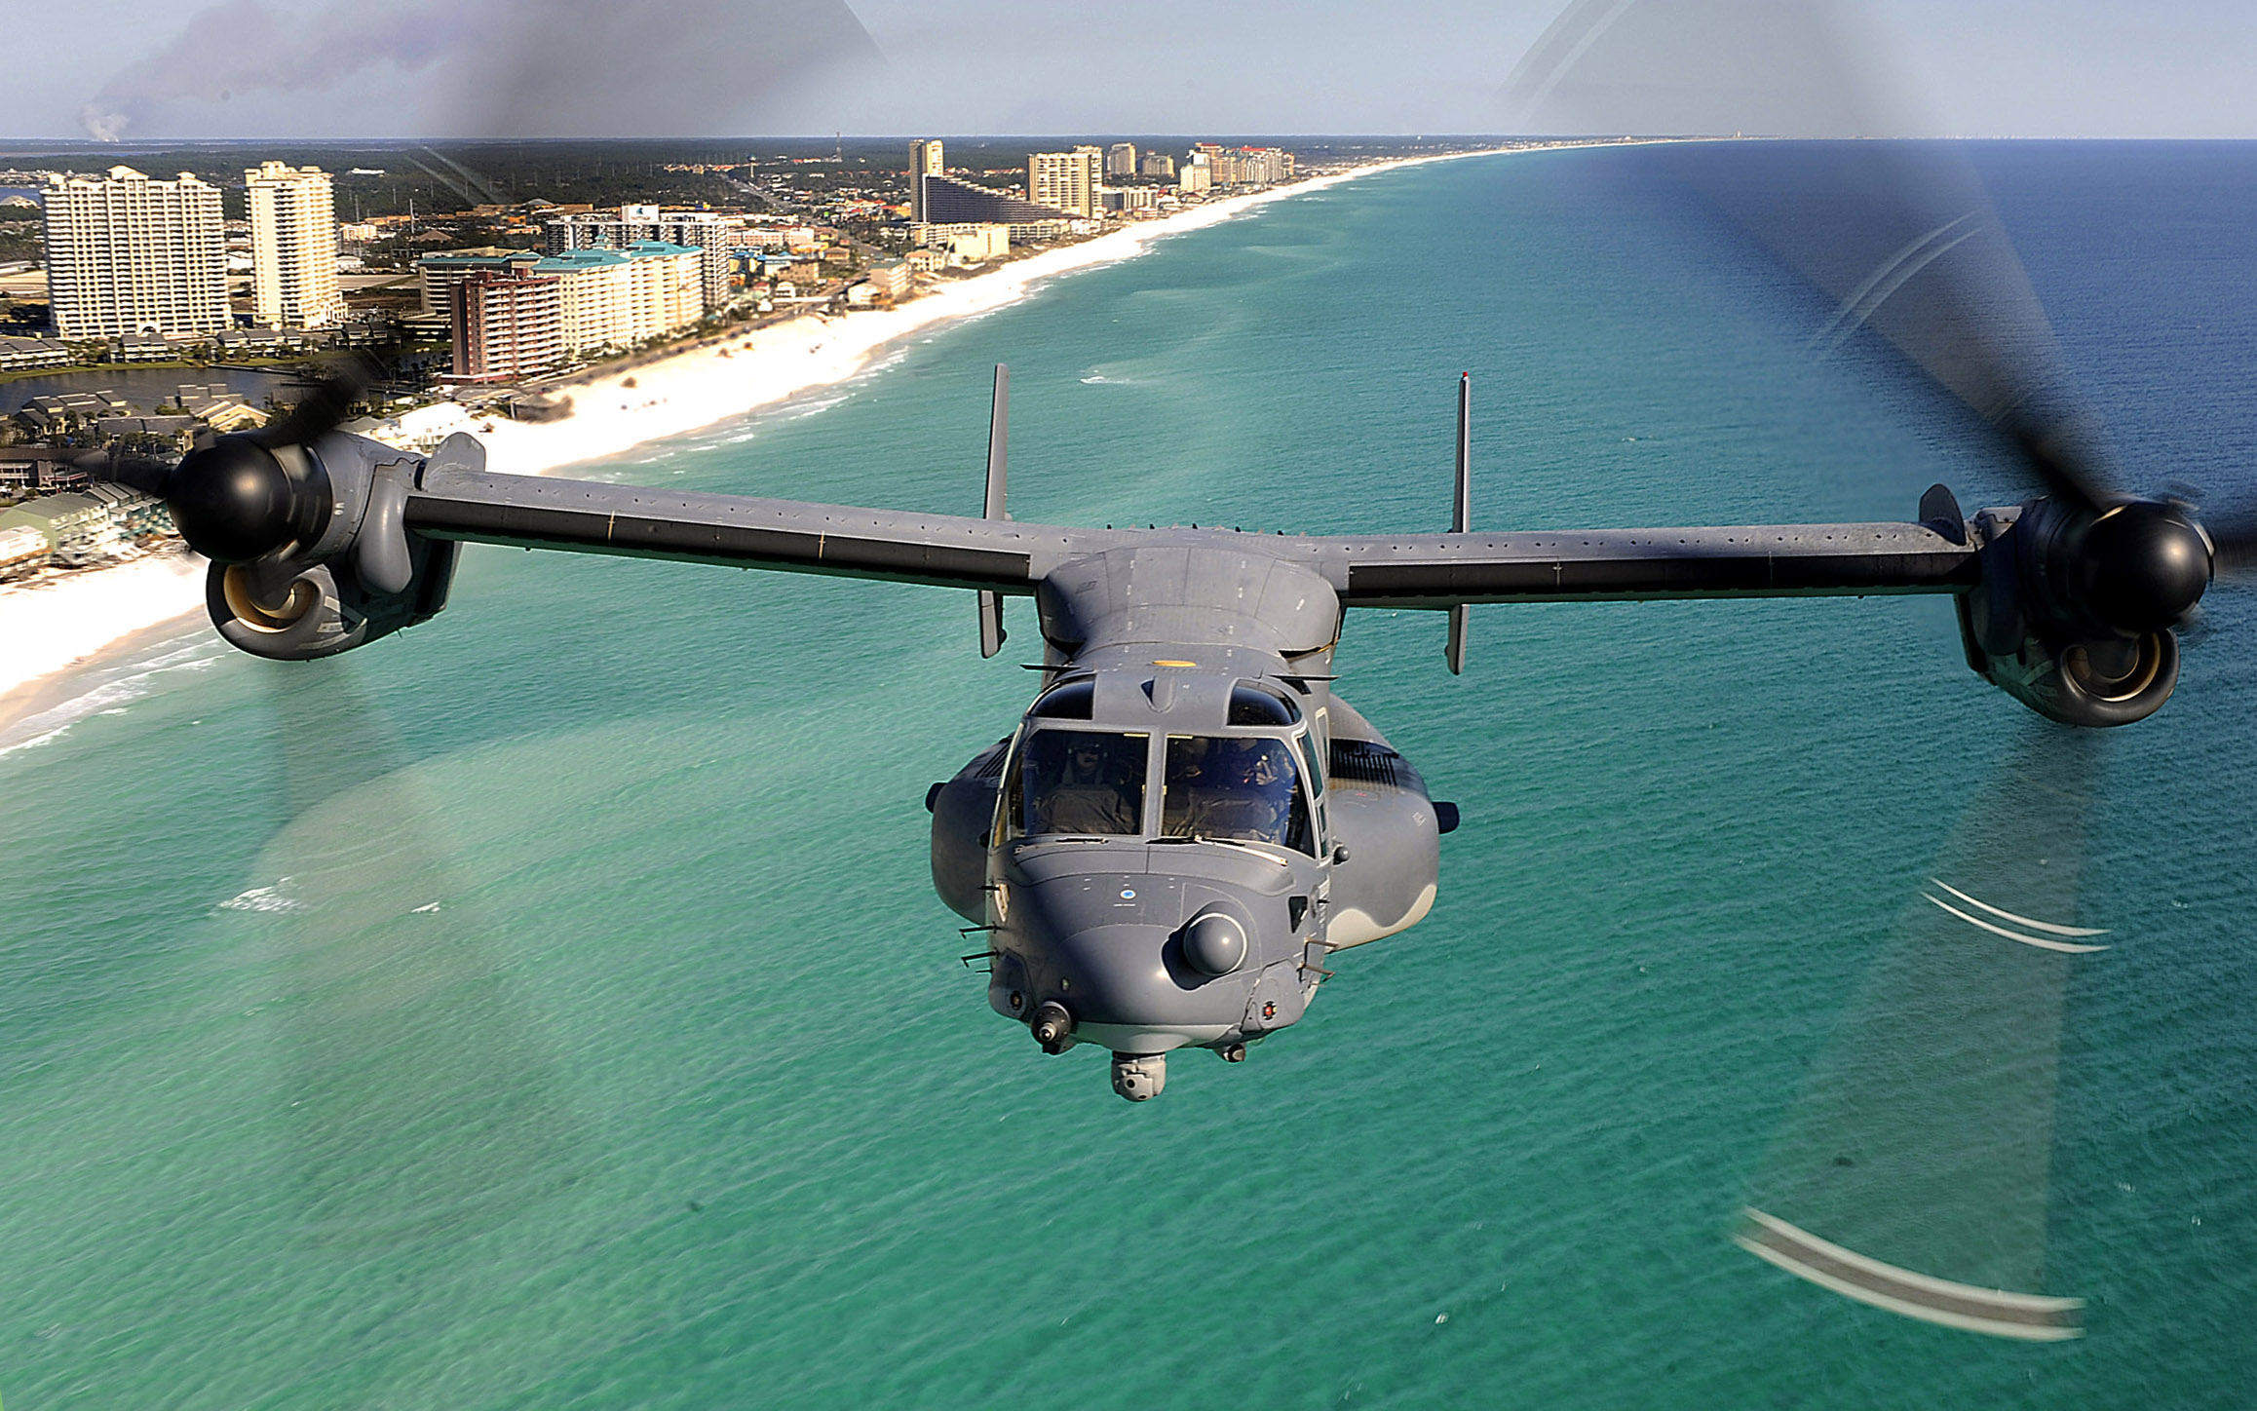
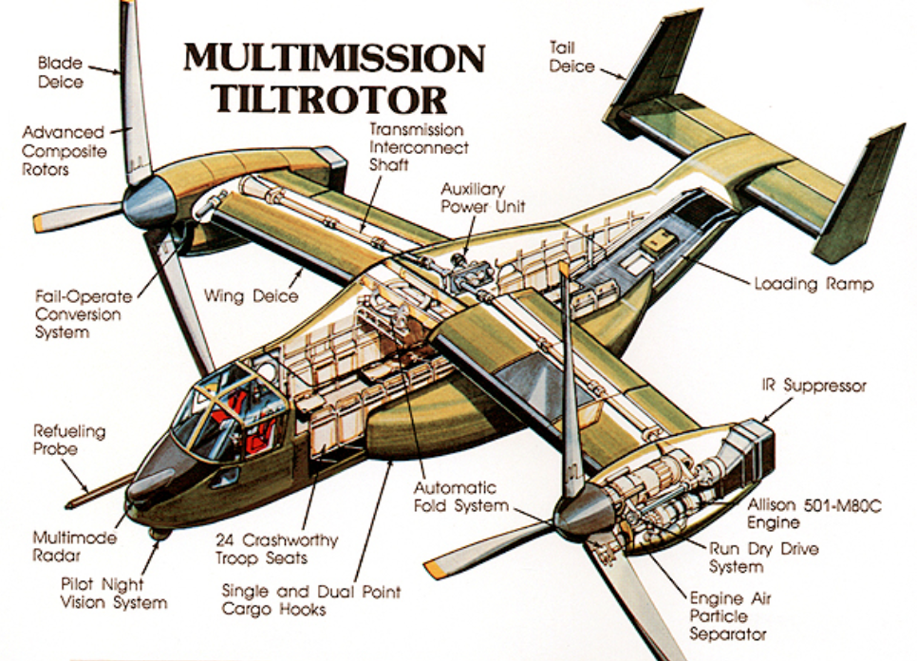
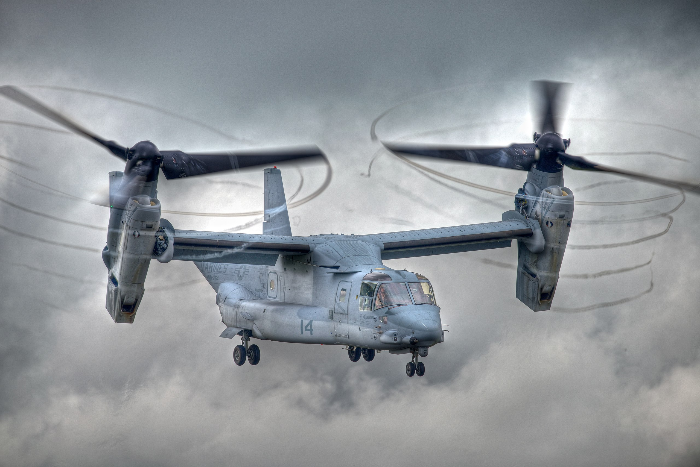
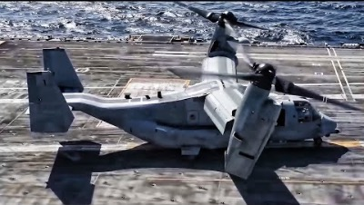
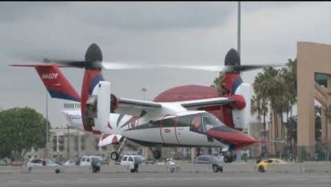
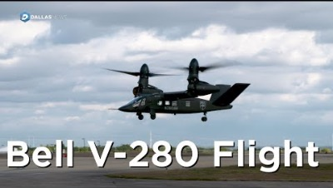
Tilt-rotor

Slide 17
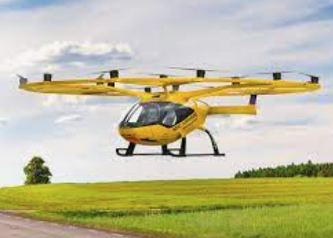
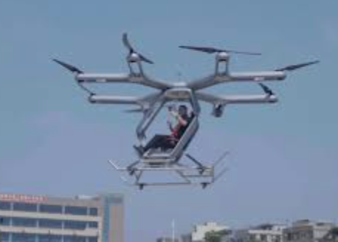
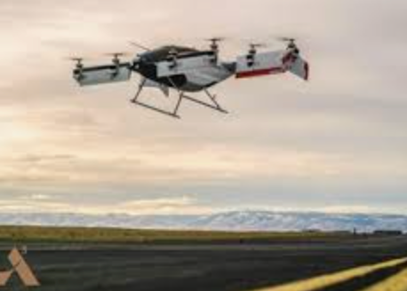
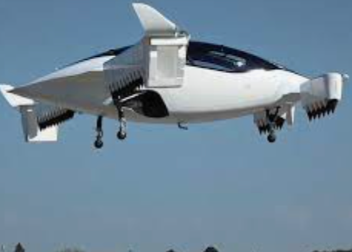
eVTOLs
“architecture… based on principle and not precendent” – (structural architect) Santiago Calvatra

Slide 18
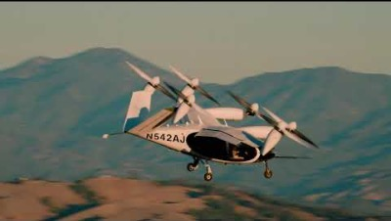
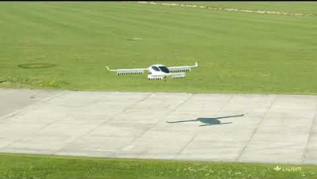
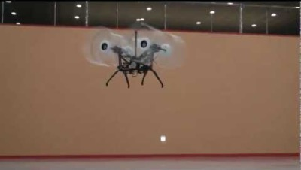
Electric/Hybrid VTOLs^{[1]}
Obviate need for mechanical power transmission
Electrical wiring is much lighter than shafts!!
Electric motors can operate at any RPM (unlike Turboshafts)

Slide 19
Autogyro (unpowered rotors)
Some control provided by rotors
longitudinal and lateral control via cyclic pitch
yaw control possible via rudders only (so not very responsive, sideslip landing-related accidents!)
…

Slide 20
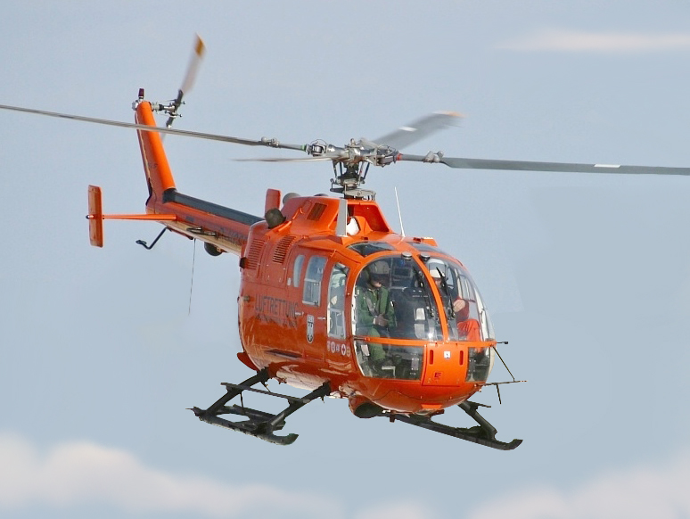
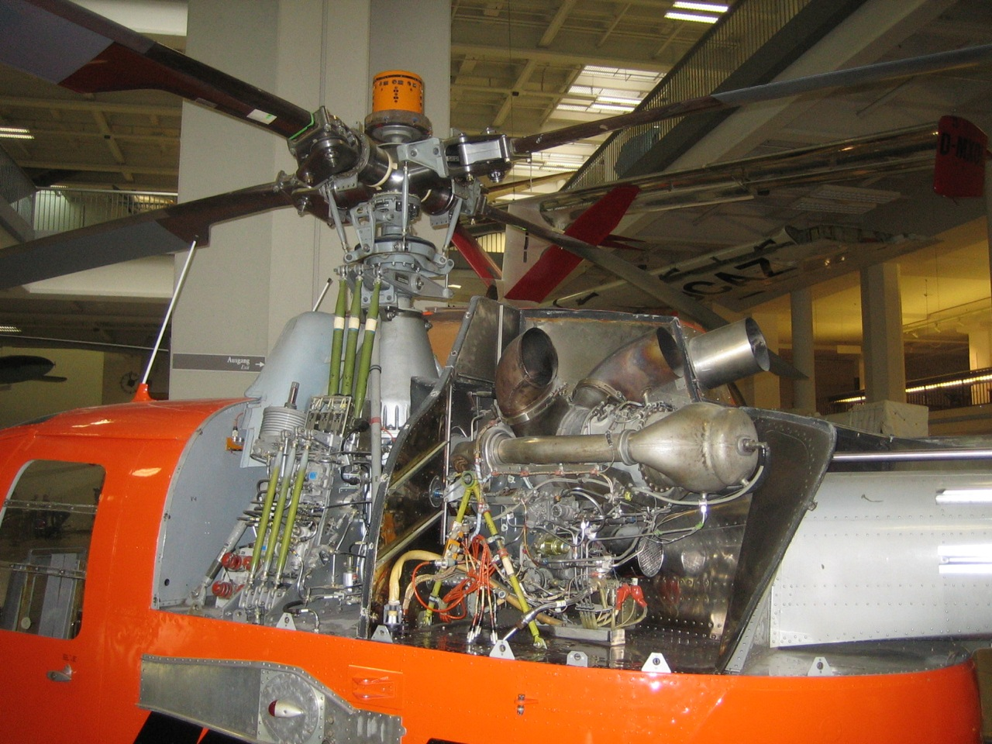
The structure

Slide 21
Aero
“No one can realize how substantial the air is, until he feels its supporting power
beneath him. It inspires confidence at once”
- Otto Lilienthal (1848-1896) was a German aviation pioneer and completed
numerous successful glider flights

Slide 22
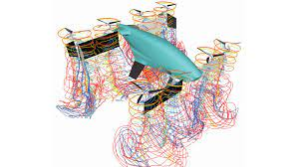
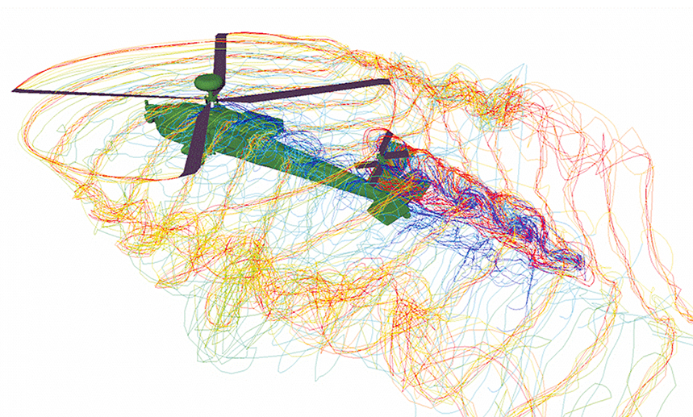
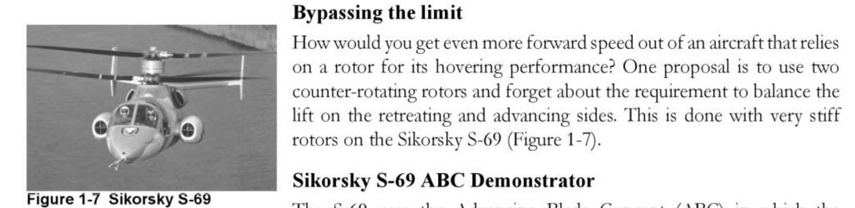
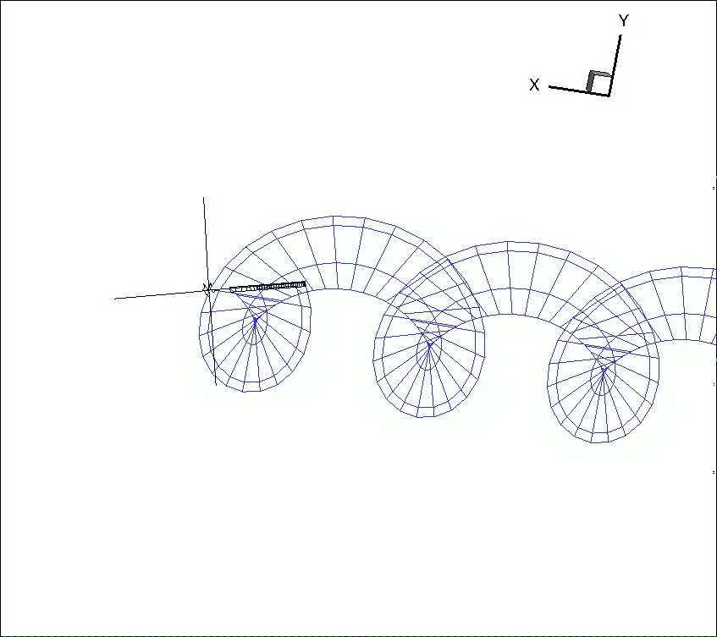
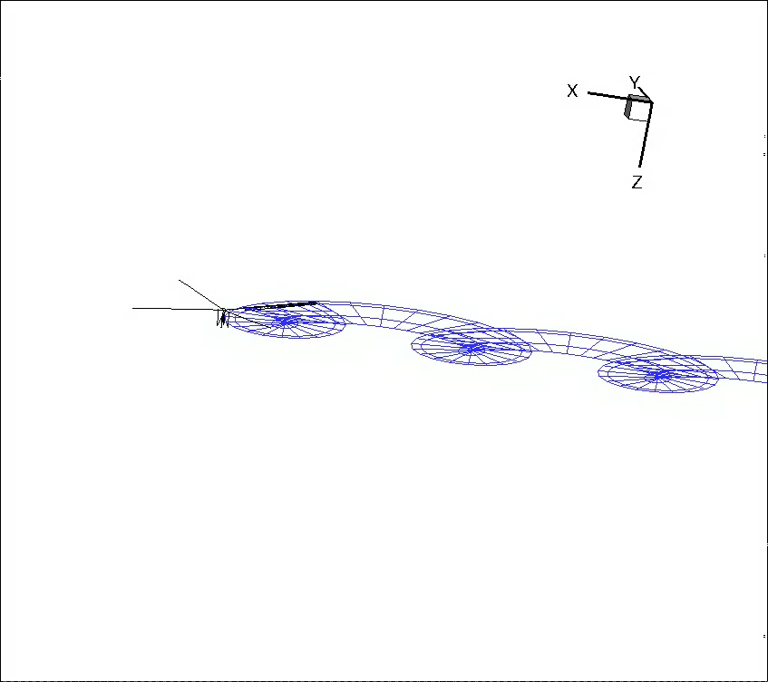
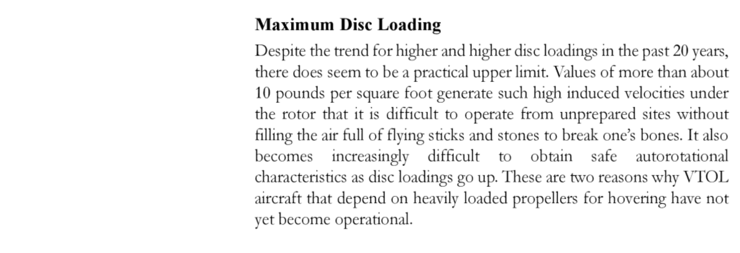



Aerodynamics
Effect of rotors operating on
Notes:
Fluid (or air in this case) is a continuous medium, so what might be these lines shown here in color in the above two configurations and in blue in the below configuration that somehow are a good representation of what is happening in reality

Slide 23
The not so Almighty NS equations!!
Fail when
very low densities (high altitude)
shocks, where a lot happens in a small length scale and continuum assumption may not be valid
dlkf

Slide 24

The Almighty NS equations!!
within the realm of their application, they are as good as a theory can be
“a highly accurate physical theory that can predict practically all phenomena of interest in aerodynamics”
klkl
no slip condition
”even the smoothest surface is rough on the scale of molecules”
based on Kinetic Theory avg tangential velocity (slip velocity) is effectively zero
sls

Slide 25
The not so Almighty NS equations!!
Fail when
very low densities (high altitude)
shocks, where a lot happens in a small length scale and continuum assumption may not be valid
dlkf

Slide 26
(Higher level) Aerodynamic conceptual models
ALWAYS keep limitations/assumptions of any model in mind!
also valid for NS eqns!
particularly relevant for higher level models like MT, BEMT
sd

Slide 27
At the center of it all
Airfoils as fundamental lift generating entities
Newton’s explanation for lift generation wrong
But Newtonian principles at the root of NS equations
jkj

Slide 28
Momentum theory
“﻿Understanding simultaneous behavior over an extended spatial domain is inherently difficult, and the problem of local physics versus global flow behavior contributes to the difficulty. The basic physical laws impose relationships between flow quantities locally, while global behavior is constrained by the requirement that these laws be satisfied everywhere simultaneously. A flowfield is a global phenomenon in which what happens at one point depends to some extent on what happens everywhere else.” – excerpt from Understanding Aerodynamics by Doug McLean

